Slide 1
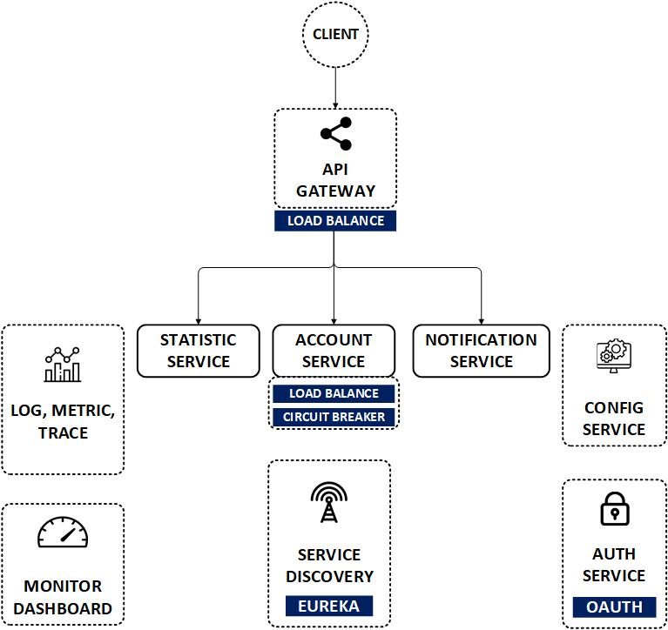

Spring Cloud Gateway Route Code
www.jmaster.io/course/microservices-with-spring-cloud

Slide 2
